Slide 1
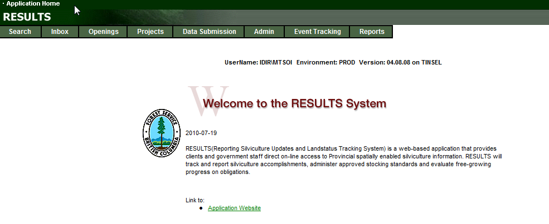
RESULTS Spacing Reporting
December 2012

Slide 2
Background
Spacing activity is conducted on young stands soon after free growing on pre-existing silviculture obligations openings.
There is a requirement to maintain data integrity of pre-existing openings to enable tracking and reporting of silviculture obligations.
Preference is to use shell openings for reporting of Spacing Activities where possible.

Slide 3
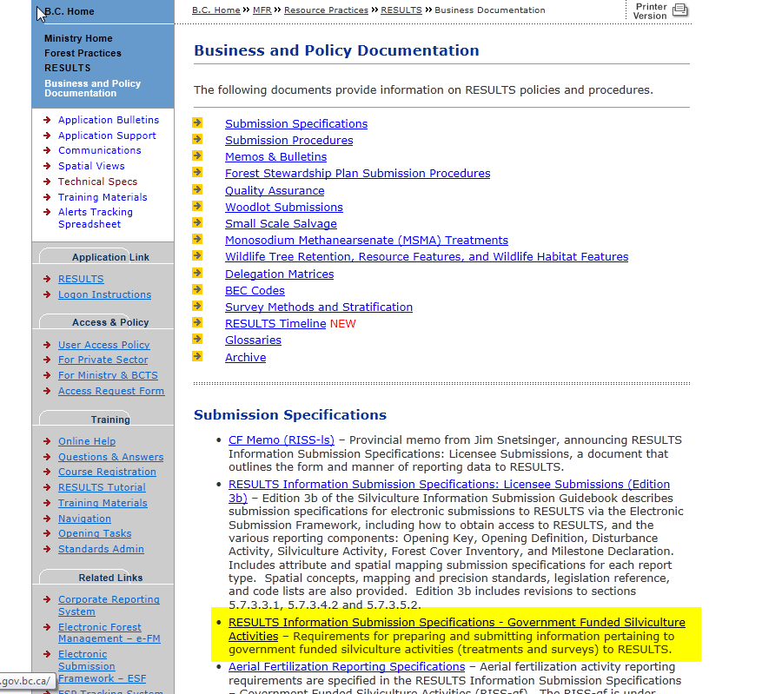
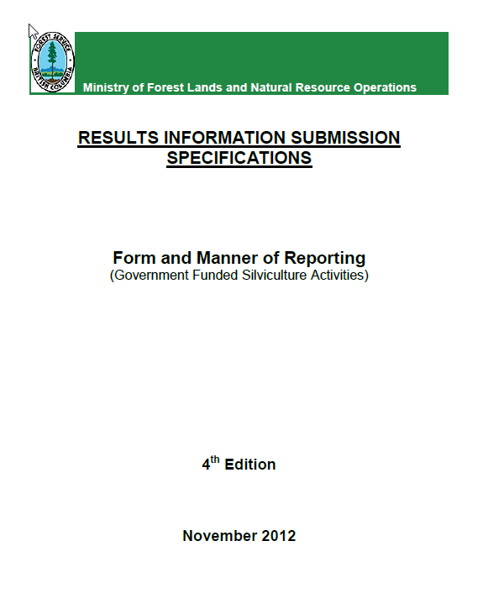
Key References
http://www.for.gov.bc.ca/his/results/business.htm
Pending new RISS-gf available on the Business documentation webpage with new section on Juvenile Spacing

Slide 4
RISS – Spacing
General Steps
Create shell opening – must go online to create New Shell Opening
Once opening created added information online
Provide disturbance reporting if none pre-existing
Use ESF submission tool to set up ESF spacing activity reporting xml with activity GML map
Provide any required planned or completed activities relating to spacing activity with activity GML
Use ESF submission tool to supply forest cover post-spacing with spatial.
Add any attachment requirements

Slide 5
RISS – Spacing
Creating a Shell Opening
Create shell opening – must go online to create New Shell Opening
Opening Category – NREQ
  Opening Gross Area – enter treatment area
  Approval Date – initial spacing eligibility survey date
  No SUs are required.
  Require subsequent ESF submission for Opening spatial.
  Opening ID – for shell opening used for subsequent updates
2. Once Opening created added information online
Set Opening Status to “FG” (District staff to set)
Set Timber Supply Block – assist in TSB & reporting

Slide 6
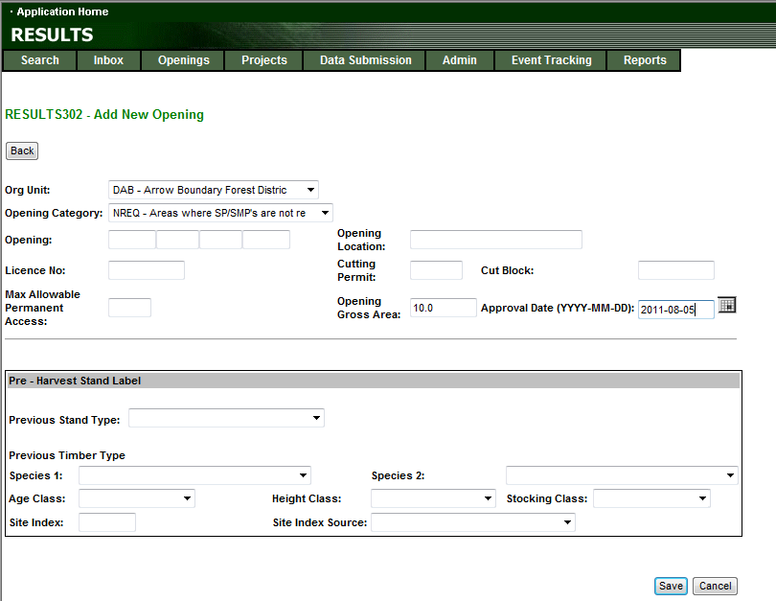
Online – Creating Shell Opening

Slide 7
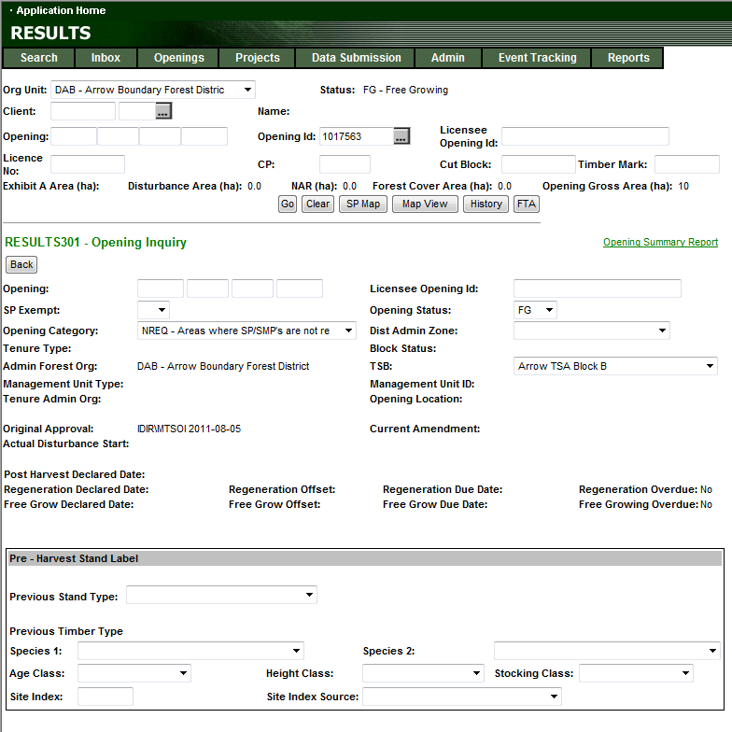
RISS – JS Shell Data Requirements
Opening ID generated is used for subsequent updates and for ESF Submissions as the key
Set opening status to “FG”
Specify TSB

Slide 8
Reporting Components
3. Use ESF Submission Tool to provide Opening Spatial
4. Use ESF or Online to submit Disturbance Report
Disturbance report is mandatory to enable Forest Cover Submission.
Not required if any disturbance reporting already exists.
Use Opening ID as the key
  Add Disturbance Activity
  Mandatory data for disturbance reporting:
    Disturbance Start Date: use eligibility JS survey date
    Disturbance Area: 0.1ha (minimum impact on disturbance reporting)
    Disturbance Code: E – Stand Enhancement

Slide 9
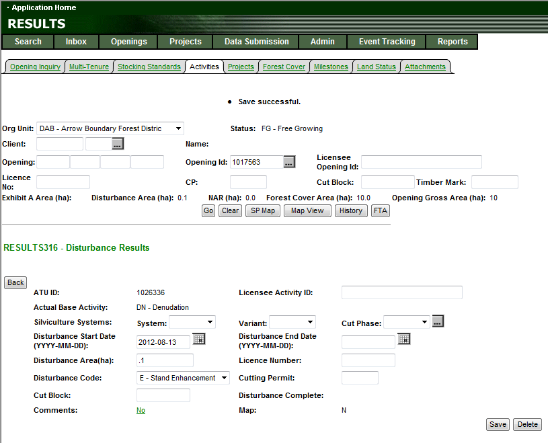
Reporting Components
Disturbance Report – ESF or Online

Slide 10
Reporting Components
Spacing – ESF Only (spatial required)
5. Use ESF Submission Tool to set up ESF Spacing activity xml with Activity GML Map.
Use Opening ID as the key
  Mandatory data:
    Base: JS
    Tech: MA (Manual)
    Method: MANCT or POWER (or valid code combination)
    Funding Source: FTL (Licensee administered) or FTM (Ministry administered)
    Inter-agency No: mandatory for completed activity (<rst:fundingProject/>)
    Date: can be planned or completed
    Area Treated
    GML Map
Note that the Activity Spatial is a requirement for completed spacing activities.
May add other planned or completed activities related to Juvenile Spacing activity

Slide 11
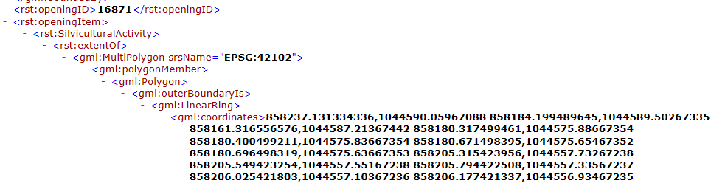
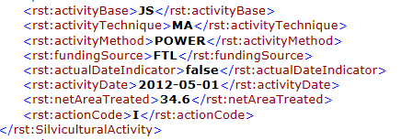
Use of Actual Date Indicator & Action Codes
ESF File looks something like this:
rst: fundingProject = Inter-agency Number online
rst: actualDateIndcator
true = completed activity
false = planned activity
Action – “I”-Insert new reccord
Action – “U” Update of existing record

Slide 12
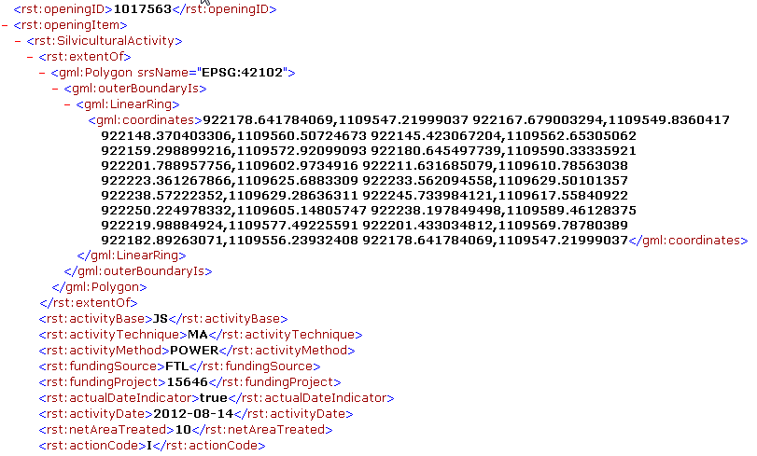
Reporting Components
Spacing – ESF Only (spatial required)

Slide 13
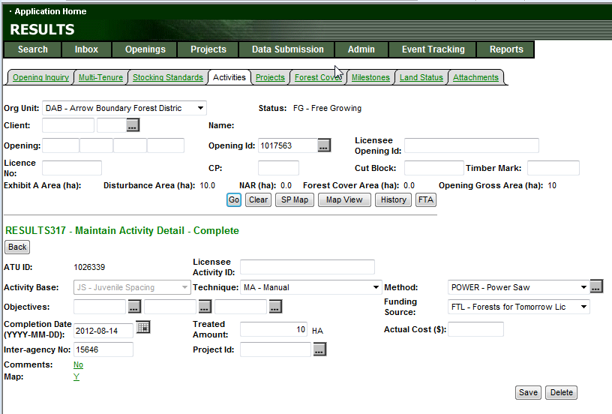
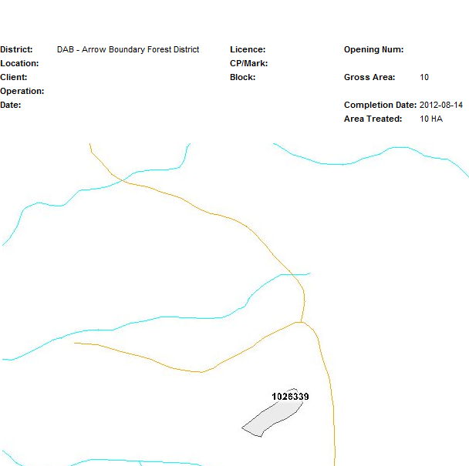
Reporting Components - ESF
Completed JS Activity
Spatial mandatory requirement

Slide 14
Types of Reporting tied to JS Activities
Eligibility Survey – (SU/JS/Method, Objective: JS)
Planned JS Treatment– (JS/Tech/Method, Objective: JS)
Completed JS Treatment – (JS/Tech/Method, Objective: JS)
Survey Activity (post-treatment) – (SU/JS/Method, Objective : JS)
All the above require an Activity Map

Slide 15
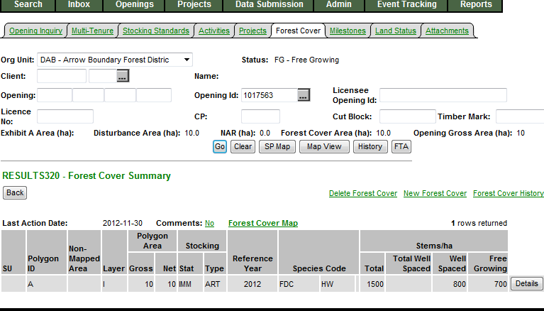
Reporting Components - ESF
Post-Spacing Forest Cover
6. Use ESF Submission Tool to supply forest cover post-spacing with spatial.
Use Opening ID as the key
  Provide forest cover updates based on spaced activity with forest cover spatial.
  Note that only the spaced area is required to be reported under the shell opening.

Slide 16
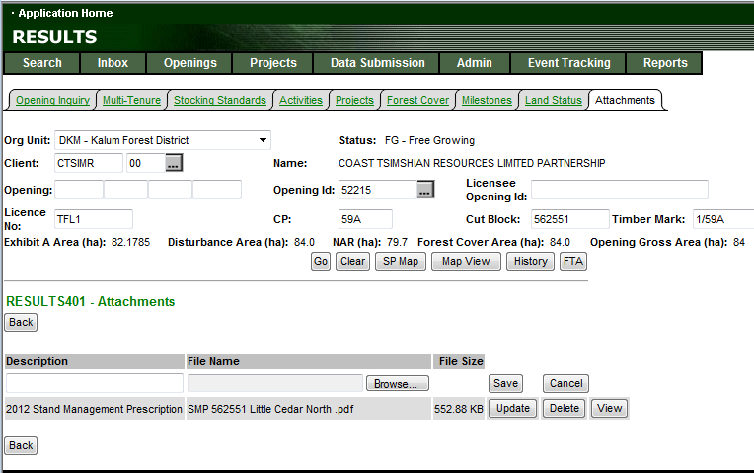

Attachments - See Attachment Standard
Mandatory requirements for attachment outlined in Recipient Agreements
http://www.for.gov.bc.ca/his/results/RESULTS_Attachment_Standard_for_Government_Funded_Programs_20100716.pdf

Slide 17
Reporting on Pre-existing planned activities – Need to close the loop
If there is existing planned activities you are reporting against, you must report against these planned activities. Must use the same opening to report against using “U”-Update Action Code and by using ATU_ID in submission as Licensee_ID to enable ESF to refer and update record.
Must be done via ESF due to spatial requirement.

Slide 18
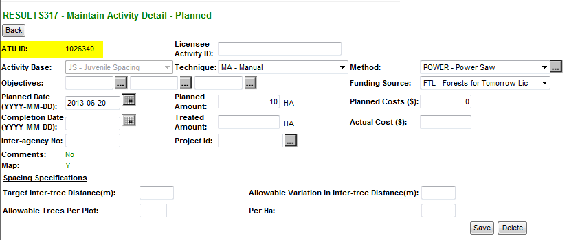
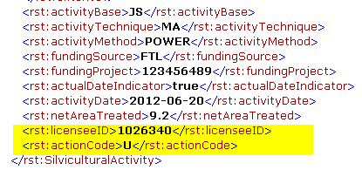
RESULTS – ESF Confirmation Planned Activities
ESF set up:
Action “U” - Update
Use of ATU ID = <licenseeID>
Enables ESF to identify update of existing planned activity

Slide 19
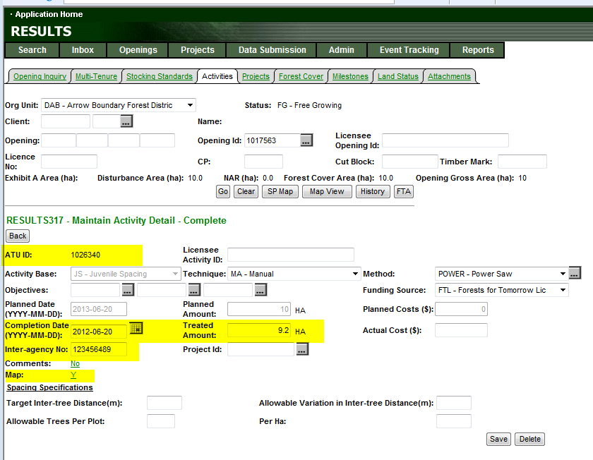
RESULTS – ESF Confirmation Planned Activities

Slide 20
Why Forward Plan?
Forward juvenile spacing planning requirements is current recommended for three years ahead. If anything greater than 3 years recommend providing a planned survey for re-assessment.
All budget requests are based on field-based requirements.
Planned activities from RESULTS is used to build the business case.
Planned areas will demonstrate on the on the ground needs based on required pre-assessments, stand management prescriptions and demonstration of ability to deliver operationally to ensure achievement of goals.
Planned areas will have to be managed but this is a necessary work requirement to support funding requests.

Slide 21
Usage of information from RESULTS
  Accomplishment Reporting - when & area for program delivery tracking purposes – this is the Activity Screen data supplied.
  RESULTS Activity GML – this information can be used via LRDW for anyone who may want overlay silviculture activity.
      Strategic review by TSA (Silv Strategy)
      Timber Supply Review- incorporation incremental silv activities
      Stand types where treatment took place
  RESULTS Activity GML works in conjunction with Accomplishment reporting to get details about district, TSA/TSB, when etc.
  Forest Cover Updates used to update Vegetation Inventory - VRIMS

Slide 22
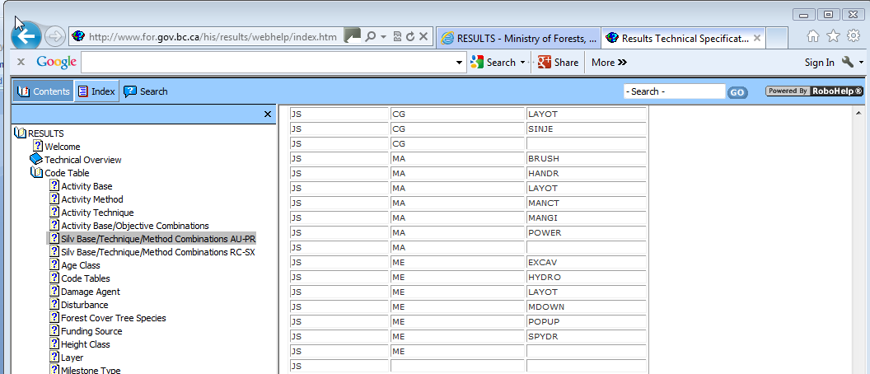
Technical Specifications
Codelists + added information
http://www.for.gov.bc.ca/his/results/webhelp/index.htm

Slide 23
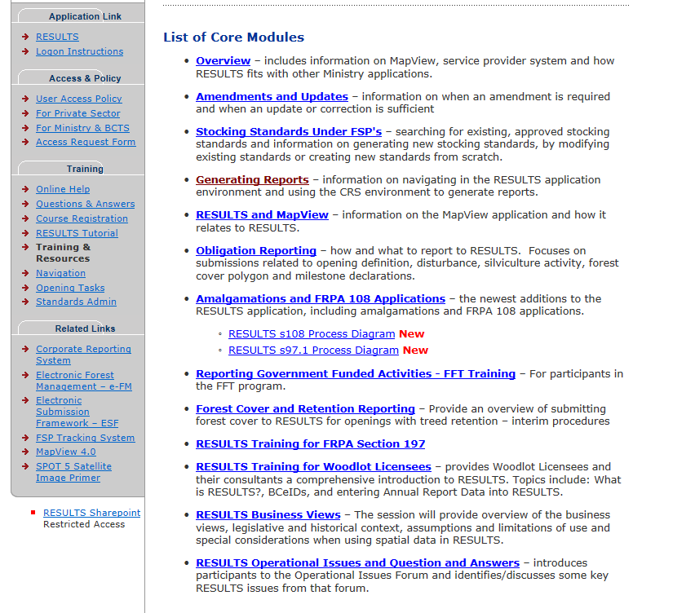
RESULTS – Training Recordings & documentation
http://www.for.gov.bc.ca/his/results/training/index.htm

Slide 24
Questions?

Slide 25
Addendum

Slide 26
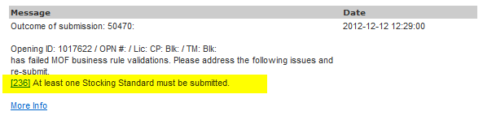
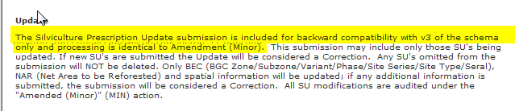
Loading of Opening Spatial
Online Add Opening creates the new opening and the Opening ID required for ESF Submission
Must set up ESF without extraneous Opening Definition to submit Opening Spatial or will receive error related to SU requirement
“U” – update for insert Opening Spatial only but note that there will be a Event created as Minor Amendment caused by RESULTS schema v3 reading “U” as Minor Event.

Slide 27
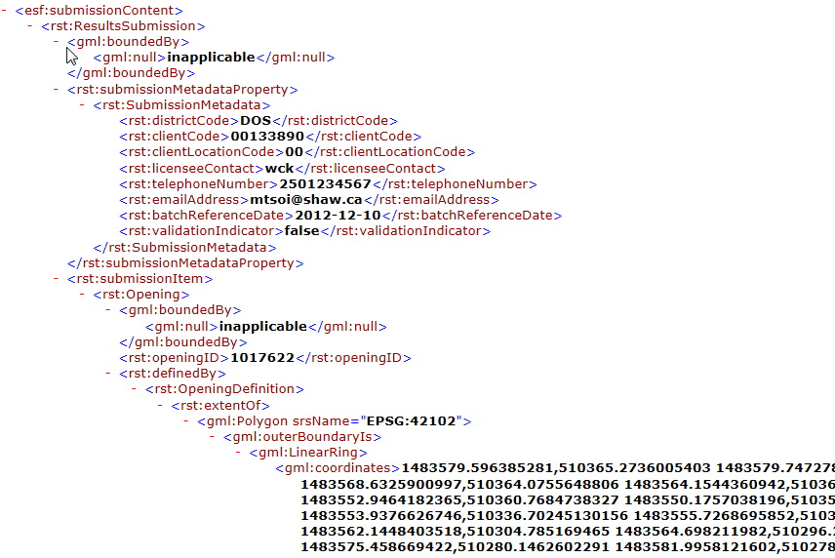
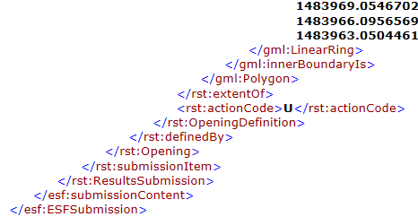
Format of Opening Spatial
Opening ID (as Key)
Provide GML of Opening Boundary representing JS treated area
Action Code = “U” -Update

Slide 28
RESULTS Information Submission Specifications - Follow-up Clarification on Juvenile Spacing (Part 13)
As the Land Based Investment Program uses multiple delivery agents and has varying funding levels it is important to capture current information in RESULTS so it is easily retrievable. The use of Shell openings provides a more streamline approach and can be used on pre-1987 blocks as well as fires where there is no licensee obligation. Following are some points of clarification for Table 16, Data Requirements for Juvenile Spacing.

Slide 29
RESULTS Information Submission Specifications - Follow-up Clarification on Juvenile Spacing (Part 13)
Eligibility Survey Activity (pre-treatment)
Inter-agency No – Mandatory – FFT project number listed in FIRS or PINES or Ministry generated number see Sec.6.2.3. Required for completed projects under a FFT project.
Comments or Attachments – Should include information outlining the areas suitable for spacing and proposed prescription as well as an assessment of the areas not suitable for treatment.
Forest Cover – Where there is new or better information collected, then the forest cover (if greater than six years old)should be updated for the entire area surveyed. This is outlined in the pre-stand tending survey and prescription development standard section 3.10
http://www.for.gov.bc.ca/ftp/HFP/external/!publish/fft_standards_on_cms_web/Surveying/Final-LBIP-Pre-Stand-Tending-Survey-Standard-March312012.pdf
Forest Cover Inventory Label
3.10 All Surveys must produce a complete updated forest cover inventory label for each Stratum, as specified in the Silviculture Survey Procedures Manual and the RESULTS Information Submission Specification - Government Submission. If a Recce Survey is performed and no treatment is recommended, and there is a current (within the last 5 years) FG survey forest cover inventory label in RESULTS that still best describes the stand attributes, then there is no requirement to update the forest cover label.

Slide 30
RESULTS Information Submission Specifications - Follow-up Clarification on Juvenile Spacing (Part 13)
Planned Treatment Activity
Forest Cover –Treatments planned for the future are linked to the surveyed area and therefore would use the same forest cover identified with the area prescribed for treatment.
Survey Activity (post-treatment)
This section can be used for either pay plots or for the Post Incremental Treatment Assessment (Use PITA Standard) which is being developed on the Coast.
Forest Cover – Forest cover should be updated if new information is collected as per the survey standard.

